Slide 1
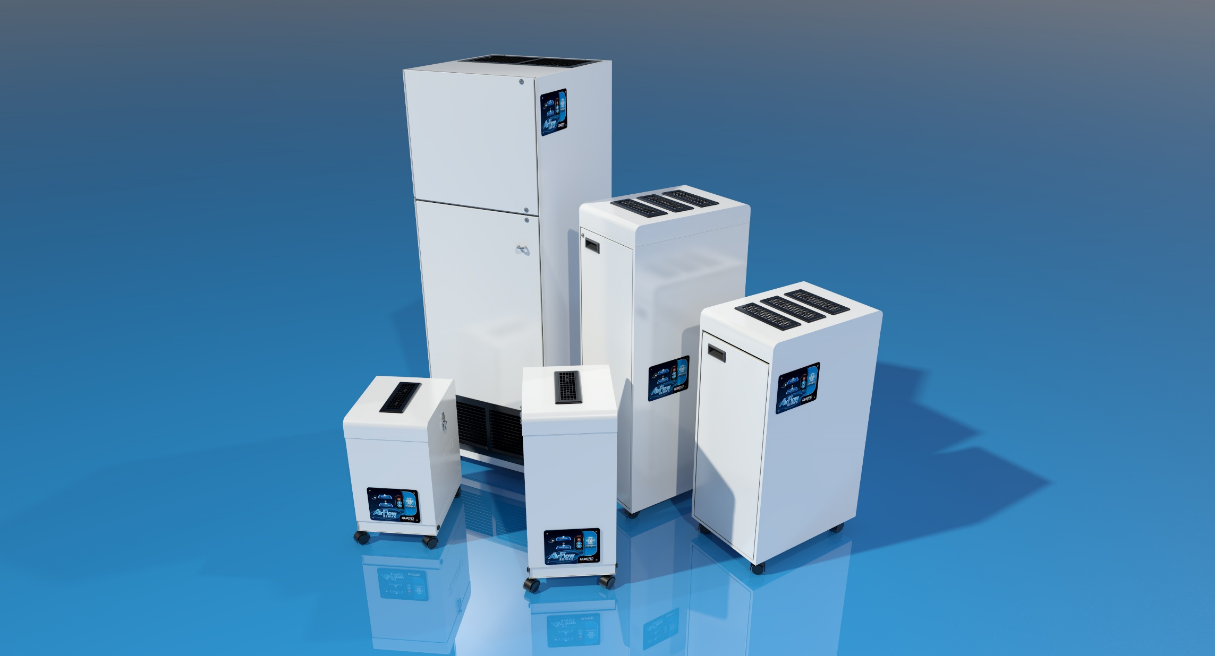


Air Purifiers
Reduce airborne particulate matter and/or odor
Notes:
As I’m sure you are aware, the topic of air purifiers has become quite important with everything going on in the world today. However, even before the beginning of this pandemic, we made sure to talk about the importance of air purification throughout all of our distribution channels.
Hospitals, dental labs, jewelers workshops, printing facilities, welding applications, flooring companies and the like were all on our radar as target markets for the distribution of our air purifiers.
But the pandemic seemed to shine a spotlight on air purifiers. And that had everyone scrambling to sift through all of the information that was now available to potential buyers. The high demand for air purifiers opened the door to so many new products made by companies that we had never even heard of before.
And although Quatro has been making air purifiers for over 30 years, we found ourselves dragged into a discussion of having to justify why they should buy a Quatro air purifier over everyone else’s.
Now we can talk about the exceptional quality that comes with domestic manufacturing. We can talk about the heavy gage metal casings that we use. We can even speak to the history that Quatro has had during the SARS and H1N1 pandemics.
But what really gets people’s attention and what sets us apart from our competition is the size and quality of our HEPA filters.

Slide 2
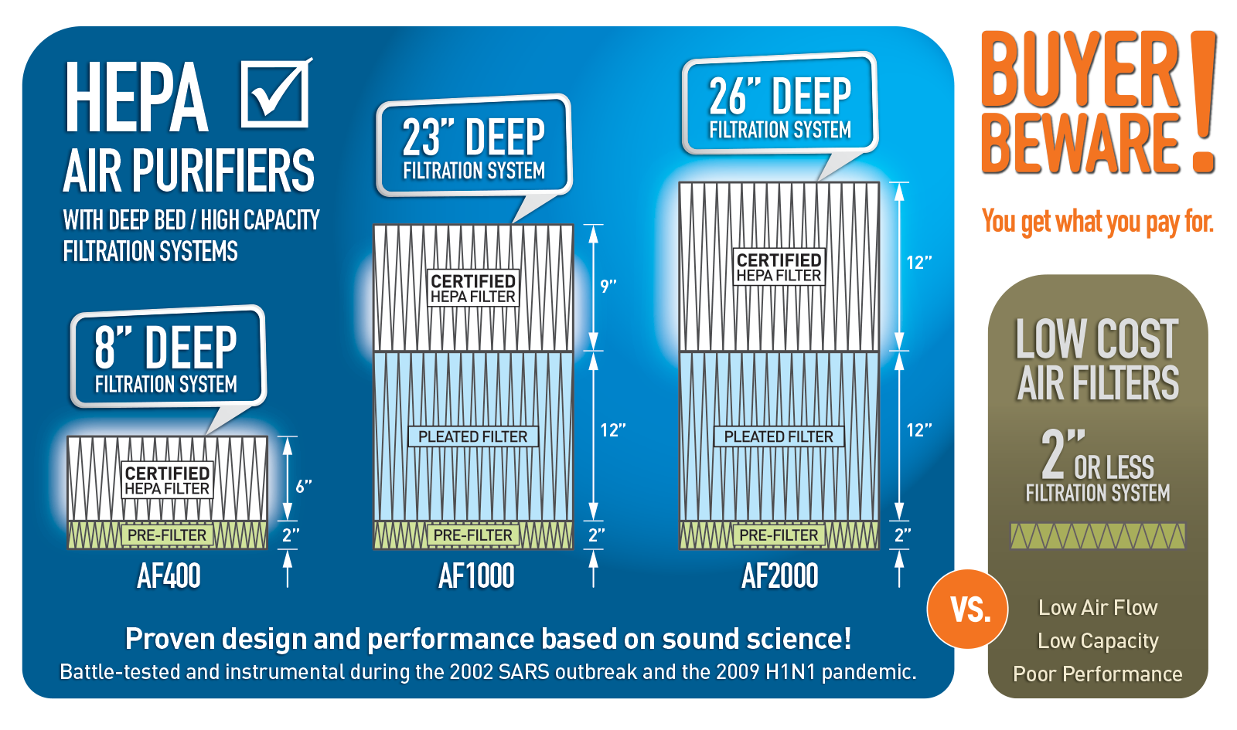
OFFERING THE COMPLETE SOLUTION
Notes:
I know that you all have a firm grasp on the quality of medical grade HEPA filters that we use, but one of the major talking points that should be emphasized is size of our HEPA filters.
Many of the less expensive air purifiers that are new to the market have much smaller HEPA filters – some as small as 1 or 2” deep. The 3 models that we will be focusing on have significantly deeper HEPAs than that. 6”, 9” and 12” HEPAs are used in our system that we’re going to talk about.

Slide 3
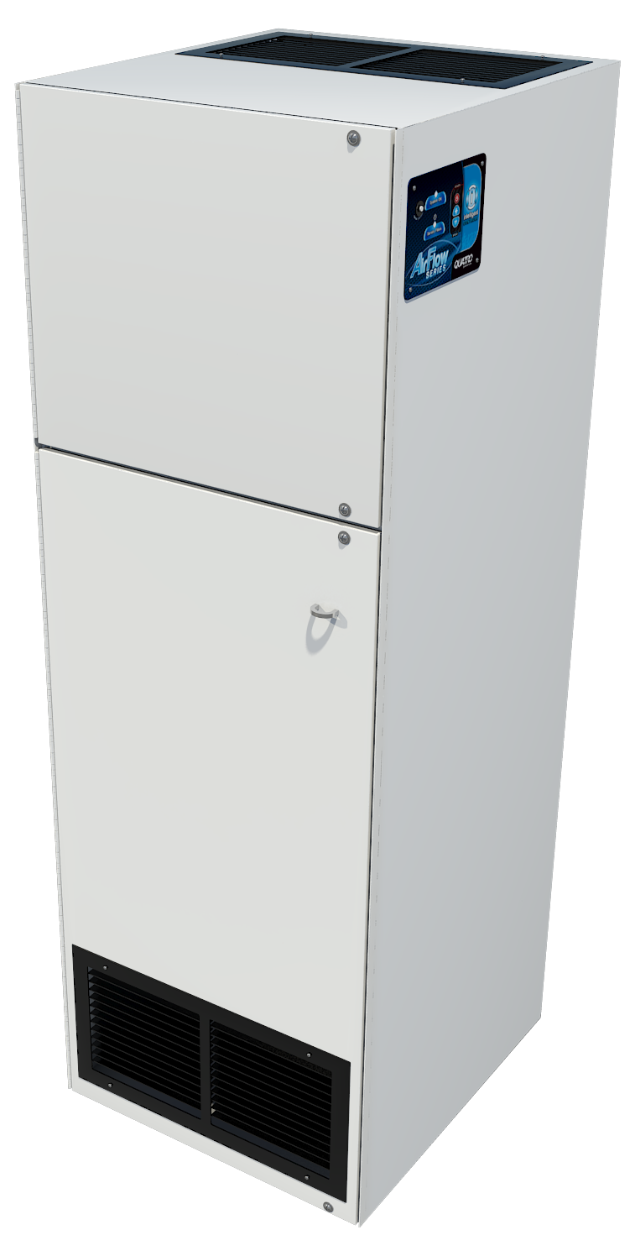
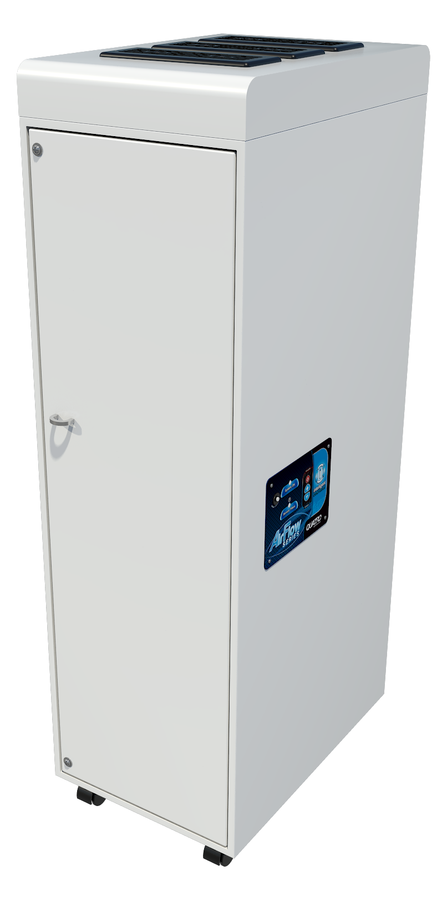
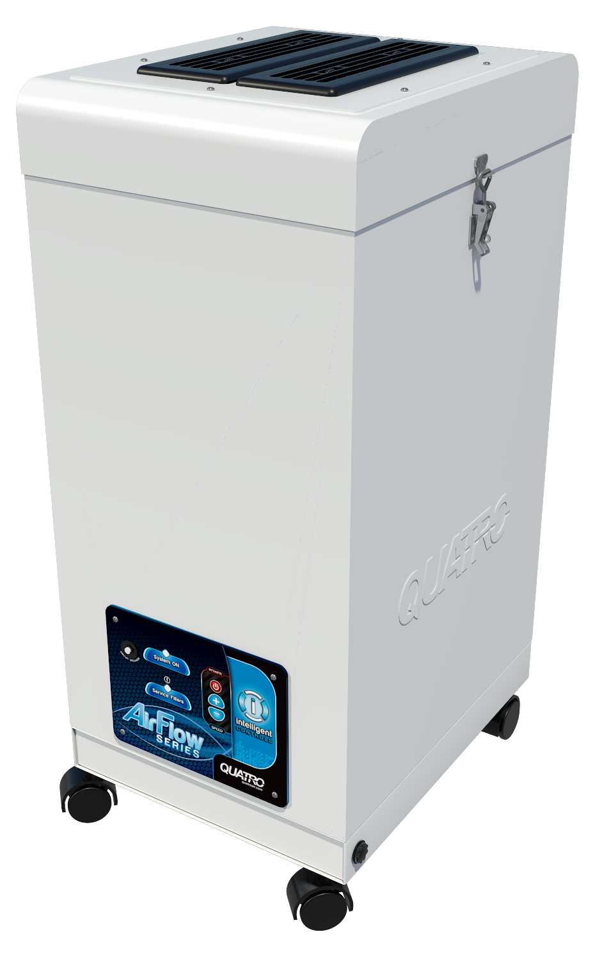
AIR PURIFICATION
Power: 120v, 60Hz / 230v, 50Hz
Ultra Quiet - <32dbA at low speed
Includes casters for mobility
Visual & audible alarms for filter maintenance
AF2000
AF1000
AF400
300 cfm
500 cfm
1000 cfm
6” HEPA
9” HEPA
12” HEPA
Notes:
We are going to show you 3 main models of air purifiers that we offer. Each model is designed to handle a different size space.
We have the [click] AF400, the [click] AF1000 and [click] AF2000. Each with a hefty HEPA filter.
[click] Each of our air purifiers can be made for use with either a 120v or 230v power source.
[click] They operate very quietly and [click] have casters to make them completely mobile.
[click] The control panels have both visual and audible alarms for filter maintenance

Slide 4
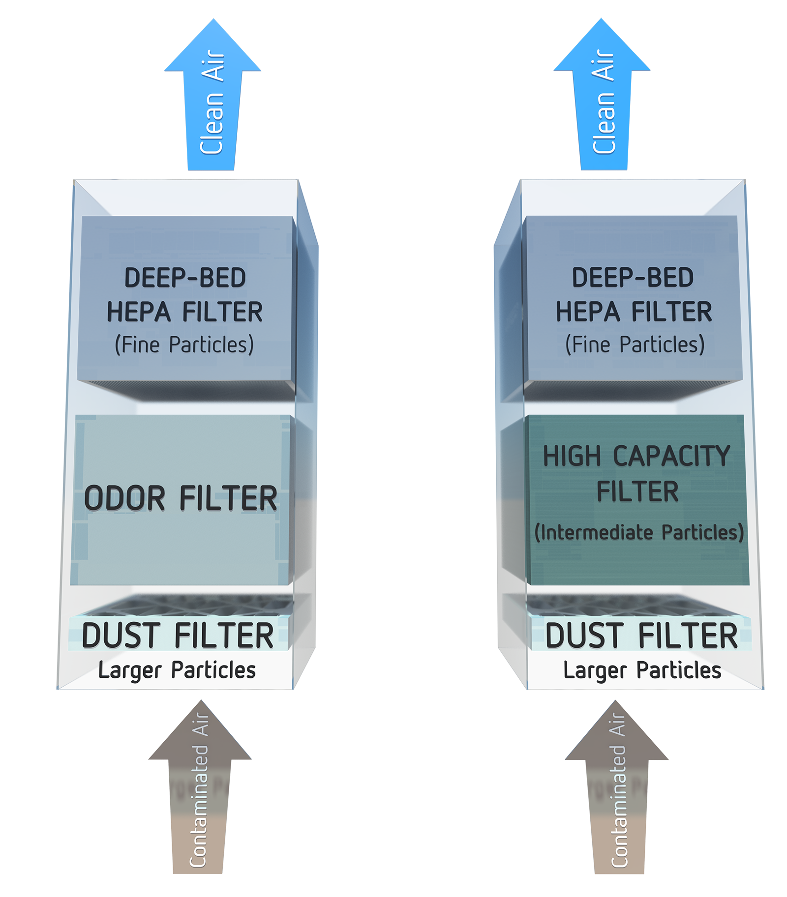
OFFERING THE COMPLETE SOLUTION
3-Stages of Filtration
Dust/aerosol only
Dust Filter – Changed every 3 months
Hi-Cap Filter – Changed every 6-8 months
HEPA Filter – Changed every 12-18 months
Dust/aerosol & Odor/VOCs/gas phase
Dust Filter – Changed every 3 months
Odor Filter – Changed every 12 months
HEPA Filter – Changed every 12-18 months
Notes:
With the exception of one of the air purifiers that we sell, all of them have 3 stages of filtration.
[click] For dust and aerosol applications,
Stage 1 is a pleated dust filter that would be expected to be replaced every 3 months.
Stage 2 is a high capacity dust filter that should be changed every 6-8 months
And stage 3 is a deep-bed medical grade HEPA filter that would need replacing every 12-18 months.
[click] In the case of an air purifier needed for dust AND odors or VOCs, the Hi-Cap dust filter is replaced with a chemical media filter suited for the specifics of the contaminants. That odor filter should be changed every 12 months or so.

Slide 5
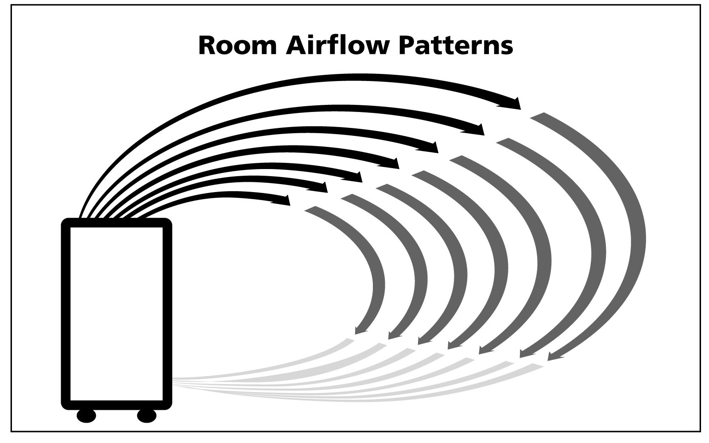
OFFERING THE COMPLETE SOLUTION
Notes:
The way our purifiers work are simple enough to understand. They are upflow systems that pull contaminated air in through the bottom and push clean air out through the top.
[click] The idea is to create an unobstructed flow of air in the room.

Slide 6
OFFERING THE COMPLETE SOLUTION
Healthcare
Industrial
Critical Applications
Bacteria, viruses, allergens, aerosols
General Applications
Dust, smoke, odors, VOCs
Low Particle Count
Goal = Eliminate particles
High Particle Count
Goal = Reduce particles
Design Feature
Locking mechanism seals HEPA filter - prevents any bypass
Cost Effective
$200-$300 less expensive
Target Markets
Hospitals, clinics, hotels, schools, reception areas, lunchrooms, offices, meeting rooms
Target Markets
Workshops, CNC machining areas, welding facilities, paint shops, flooring companies
Notes:
To help make things easier to sell, we have grouped our air purifiers into 2 categories. [click] Healthcare and Industrial.
[click] The Healthcare category of purifiers are designed for more critical applications associated with contaminants like bacteria, viruses, and aerosols.
[click] Whereas Industrial purifiers are better suited for general dust particles, smoke, and VOCs like Methyl Methacrylate.
[click] The healthcare systems are used in environments where the particle count is fairly low and where the goal is to eliminate them altogether.
[click] Industrial is designed to handle higher concentrations of particulate where the goal is to reduce them to more manageable levels.
[click] Healthcare units have a specially designed locking mechanism that seals the HEPA filter in place in order to prevent any bypass. When dealing with bacteria and viruses, you want to make sure all of the airflow goes though the HEPA filter.
[click] Industrial systems are designed to handle particles that are not necessarily a severe health risk. So, by removing the HEPA seal mechanism, and lowering the manufacturing cost, we can offer a more competitively priced air purifier.
[click] Some of the examples of the target markets for the healthcare units include Hospitals, hotels, schools, reception areas, lunchrooms, offices, and meeting rooms.
[click] Industrial units belong in workshops, CNC machining areas, welding facilities, paint shops and companies that specialize in floor finishing to name a few.
I think this grid gives you a pretty good idea of where to draw the line between the 2 categories.

Slide 7
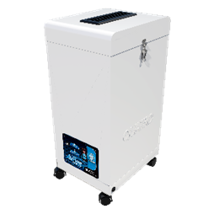
OFFERING THE COMPLETE SOLUTION
Industrial
Healthcare
1-0016-0020
(2-stage)
2 ACH: 1,125 ft²
4 ACH: 560 ft²
6 ACH: 375 ft²
^{(based on 8ft ceiling)}
Dust Only
1-0018-0003
Dust & Odor
1-0018-0004
n/a
AF400
Dust Only
1-0013-0040
1-0013-0020
2 ACH: 2,250 ft²
4 ACH: 1,125 ft²
6 ACH: 750 ft²
^{(based on 8ft ceiling)}
Dust & Odor
1-0013-0035
1-0013-0041
AF1000
Dust Only
1-0012-0051
1-0012-0007
2 ACH: 3,750 ft²
4 ACH: 1,850 ft²
6 ACH: 1,250 ft²
^{(based on 8ft ceiling)}
Dust & Odor
1-0012-0052
1-0012-0017
AF2000
Notes:
Within the 2 categories, we have the option for each unit to cover a dust only application or a dust & odor application.
So for example, [click] the AF2000 has 4 different part numbers covering dust only and dust & odor applications for Industrial and Healthcare categories.
Same goes for the [click] AF1000.
For the AF400, [click] we follow the same principle for the Industrial category. However, because we are dealing with a lower concentration of particles for the Healthcare systems, [click] we eliminated the Hi-Cap and Odor filters, and use a smaller casing in order to make it more compact and more affordable for smaller spaces like offices and lunchrooms.
Each unit has a different cfm rating that delivers a specific number of air changes depending on the size of the room.
[click] The AF400 with a 300cfm rating, will deliver 4 air changes in a 560square foot room.
[click] The AF1000 at 500cfm will deliver the same number of air changes in a room about 1100 square feet.
And finally [click] the AF2000 moves an impressive 1000 cfm. That will give you 4 air changes in a room that is over 1800 square feet.
That should give you enough information to get the discussion started with any of your customers with regards to which unit you should be selling.

Slide 8
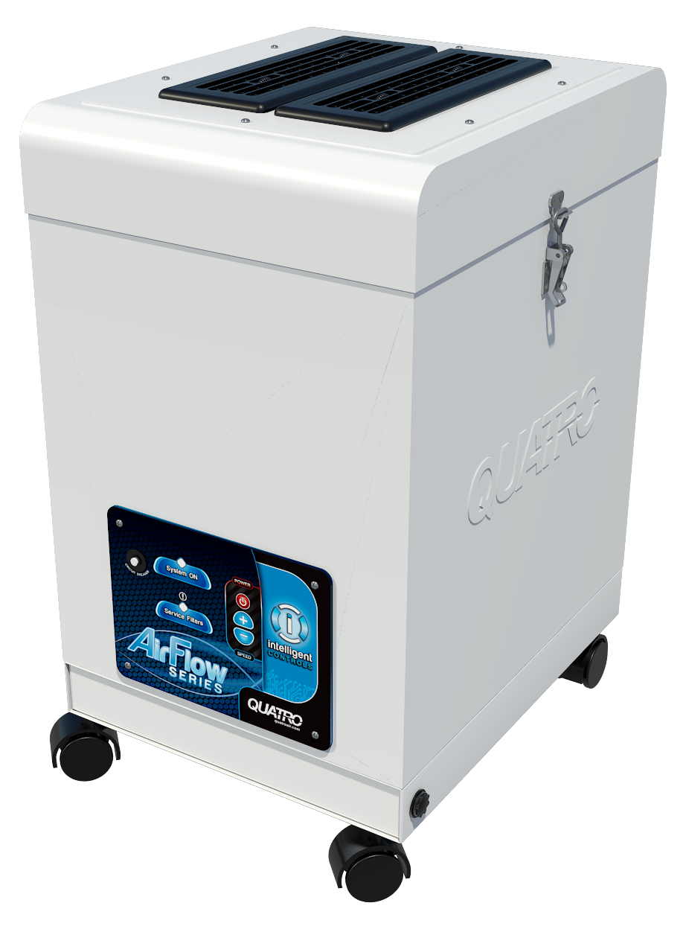
OFFERING THE COMPLETE SOLUTION
Industrial
Healthcare
3-Stage
2-Stage
AF400
30”h x 13”w x 16”d
AF400m
23”h x 13”w x 16”d
Notes:
Here you can see the difference in size between the 3-Stage AF400 for Industrial and the 2-Stage AF400m for Healthcare – the m stands for for mini.
There is a full 7” difference in height between the 2, making an ideal compact solution for offices, lunchrooms, and reception areas.

Slide 9
OFFERING THE COMPLETE SOLUTION
Notes
AF1000 and AF2000 available with UV light
AF2000 silencer option available
AF1000 and AF2000 available in heavy odor/VOC configuration
All units have negative pressure/isolation room option
Notes:
There are other noteworthy points that you may want to keep in mind when having discussions with your customers.
The topic of UV lights may come up because some of our competitors have that feature. Quatro believes that UV LIGHTS may be helpful in the control of bacteria and possibly COVID19. However, we do not believe the ideal location for the UV lights is inside our HEPA filtration systems as we believe this is redundant and the wrong location to achieve maximum results. A medical grade HEPA filter is more that sufficient to capture and trap aerosols carrying harmful viruses rendering them inactive. The UV lights would serve a greater purpose if located in the ductwork of the general ventilation system, as a separate recirculating system or directly in an AC unit.
Having said that, [click] if a customer DOES insist on having UV lights in their air purifier, Quatro does make both the AF1000 and AF2000 with UV lights as an option.
As air purifiers go, ours are among the quietest on the market. The AF2000 moves a lot of air. And yet, the motor itself is very quiet, [click] but the sound of the air being exhausted at the top of the unit can be made even quieter with the purchase of a silencer. So for the AF2000, you have that option.
[click] AF1000 and AF2000 are also available in a heavy odor/VOC configuration. By removing the HEPA filter, we have room to double up on the odor filter for those types of applications. The AF2000 can handle up to 200 lbs of chemical media.
[click] You may also face the question regarding the option to duct the exhaust to the outside. Otherwise referred to as negative pressure units for isolation rooms. [click]

Slide 10

Notes:
[click to play button for video] All of our air purifiers can be bought as negative pressure units or retro-fitted with exhaust collars to convert them to negative pressure units.
By simply changing the lid and adding a hose, our units are easily converted to duct exhaust to the outside.

Slide 11
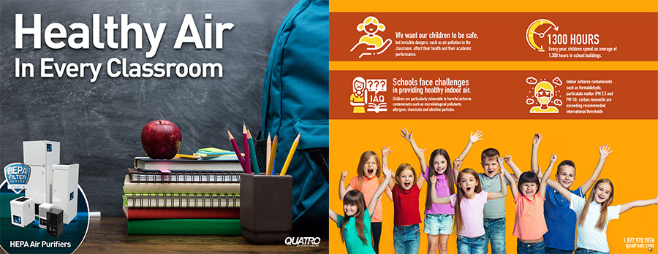
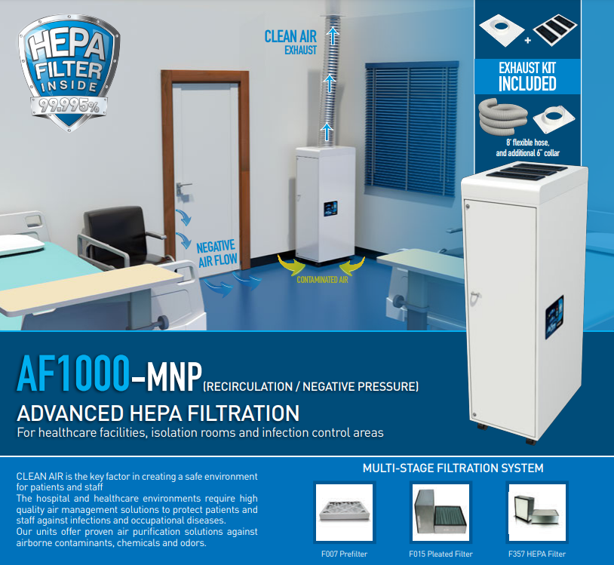
AIR PURIFICATION
Notes:
Here are just a few examples of some of the applications and target markets where we have had success.
[click] Classroom units to help control the spread of Covid 19 in classrooms all over North America.
[click] Air purifiers for the wildfires out west that we have had to deal with over the years
[click] Compact units for old folks homes and residences
[click] And Isolation room in hospitals.

Slide 12
Air Purifiers
Reduce airborne particulate matter and/or odor
Notes:
This is a brief introduction to a few of the most popular pieces of equipment that are selling well these days. If you have any questions, we would be happy to answer them here. And if something comes up later on, please don’t hesitate to reach out to us.

